Slide 1
TCS – Biostatistics and SAS Training
MedDRA/SMQ, WHO dictionaries, NCICTC current versions and new updates

Slide 2
Highlights
MedDRA/SMQ
  Introduction
  Current version and updates
WHO Drug
  Introduction
  Current version and updates
NCICTC
  Introduction
  Current version and updates

Slide 3

MedDRA/SMQ - Introduction
Medical Dictionary for Regulatory Activities
An EU regulatory/ICH initiative established in the 1990s for standardised medical terminology
Maintained by MedDRA Maintenance and Support Services Organization (MSSO)
Available in multiple languages, hierarchical structure (SOC>HLGT>HLT>PT>LLT).
Mandatory for ICH e-submission standards: eCTD (ICH M8) and ICSRs (ICH E2B).
Web-based CR tool (WebCR tool)
Current version 18.1 English September 2015
Upodated every 6 month
Next version: 19.0 March 2016 with a 27th SOC term added.

Slide 4
MedDRA/SMQ - Introduction
/SMQ (Standardised MedDRA Queries)
MedDRA terms grouped together by topics
Investigation of drug safety issues in pharmacovigilance and clinical development
Currently almost 100 SMQs have been created.
Examples
Depression and suicide/self-injury
Hyperglycaemia/new onset diabetes mellitus
Ischaemic heart disease
Cerebrovascular disorders

Slide 5
MedDRA/SMQ - Introduction
Medical Dictionary for Regulatory Activities
Key points
March 2009 - product quality terms added in MedDRA Version 12.0
May 2009 – integration of MedDRA with the CTCAE Version 4.0 for severity grading (specific to oncology).
September 2009 - vaccine related terms added in MedDRA Version 12.1
March 2012 - Pharmacogenetic and pharmacogenomic terms MedDRA Version 15.0
MedDRA Version Analysis Tool (MVAT) - September 2012
For more info:
https://www.meddra.org

Slide 6
MedDRA/SMQ - Introduction
Medical Dictionary for Regulatory Activities
From programmer’s standpoint
Analysis of individual medical events as well as groups of system, organ or etiology
Same terms can be groups under different SOCs
  eg. AEDECOD ‘Nasopharyngitis’ in the variable AEBODSYS grouped under ‘Respiratory, thoracic and mediastinal disorders’ as well as ‘Infections and infestations’ whereas original primary SOC being ‘Infections and infestations’
Legacy data conversion – Pre-MedDRA terms, older version integration
Ensure use of latest version in the data analysis and displays
Check with client teams upfront

Slide 7

WHO Drug Dictionary Enhanced (WHO DDE)
Established in 1998
Dictionary for medicinal product information by Anatomical Therapeutic Chemical (ATC) classes – coding prior/concomitant medicines, prohibited medicines
Unique product codes, active ingredients and therapeutic use
WHO Herbal dictionary (WHO HD) to capture herbal medicinal use
WHO Drug Dictionaries Change Analysis Tool (WHO DDs CAT)
Quarterly updates release: March 1, June 1, September 1, December 1
http://www.who-umc.org

Slide 8

NCI CTCAE
Common Terminology Criteria for Adverse Events (CTCAE)
Established in 1982 (CTC ver. 1.0 with scale 0 to 4)
Grade 5 added in CTC Ver 2.0 in 1998
In 2002, CTC Development team was formed for creation of CTCAE V3.0 (2003)
Descriptive terminology utilized for categorisation of Aes (28 categories) and Adverse Event (AE) severity grading and reporting.
Grade 1 Mild
  asymptomatic or mild symptoms; clinical or diagnostic observations only; intervention not indicated.
Grade 2 Moderate;
  minimal, local or noninvasive intervention indicated; limiting age-appropriate instrumental ADL *(Activities of Daily Living).
Grade 3 Severe or medically significant but not immediately life-threatening;
  hospitalization or prolongation of hospitalization indicated; disabling; limiting self care ADL**.
Grade 4 Life-threatening consequences;
  urgent intervention indicated.
Grade 5 Death related to AE
Grade 0 is “Absence of AE or within normal limits values”
  It is implied and not displayed, but available for each AE

Slide 9
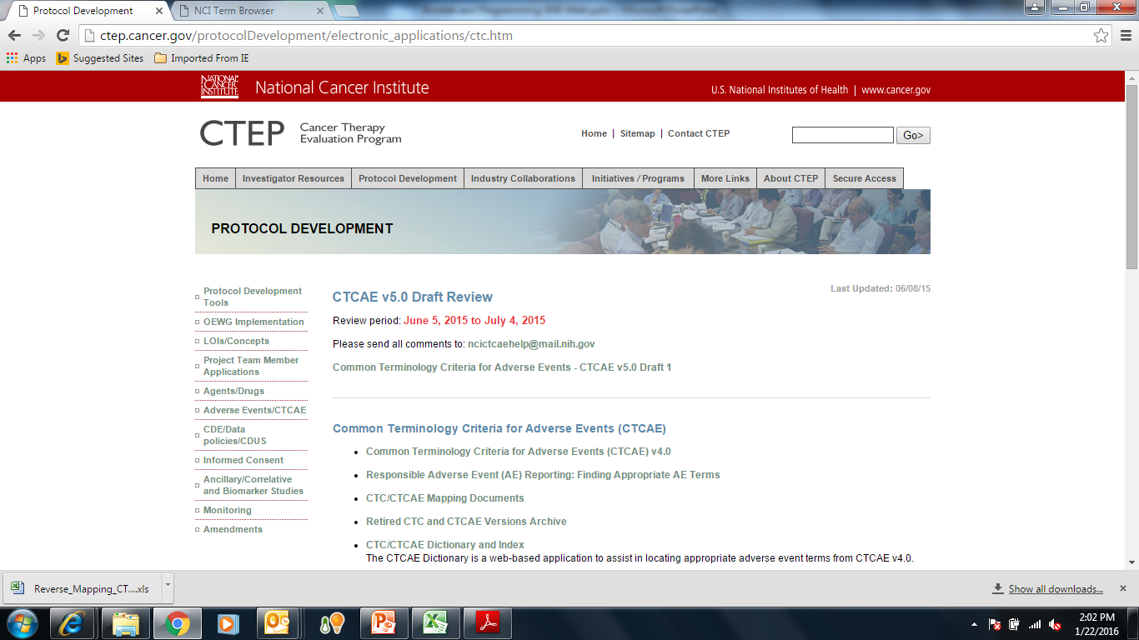

Slide 10
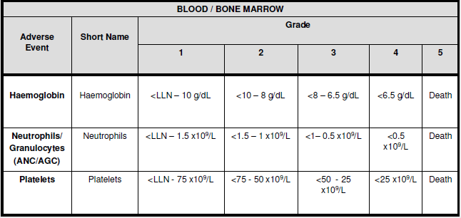
Example of laboratory criteria

Slide 11
Example of laboratory shift table
<<Laboratory test name>>
Baseline toxicity grade |  |  | Highest toxicity grade during treatment period
 |  | 1 | 2 | 3 | 4 | 5
1 |  | XX(XX.XX%) | XX(XX.XX%) | XX(XX.XX%) | XX(XX.XX%) | XX(XX.XX%)
2 |  | XX(XX.XX%) | XX(XX.XX%) | XX(XX.XX%) | XX(XX.XX%) | XX(XX.XX%)
3 |  | XX(XX.XX%) | XX(XX.XX%) | XX(XX.XX%) | XX(XX.XX%) | XX(XX.XX%)
4 |  | XX(XX.XX%) | XX(XX.XX%) | XX(XX.XX%) | XX(XX.XX%) | XX(XX.XX%)
5 |  | XX(XX.XX%) | XX(XX.XX%) | XX(XX.XX%) | XX(XX.XX%) | XX(XX.XX%)
Total
# patients with decreasing toxicity
# patients with no change from baseline or stable
# patients with increasing toxicity

Slide 12
NCI CTCAE
Common Terminology Criteria for Adverse Events (CTCAE)
Current Version 4.0
Laboratory parameters grading criteria to be programmed using applicable version
Cross checking of event count across AE tables
Upcoming Version 5:
Eosinophilia, Methemoglobinemia proposed to be added based on laboratory tests results
Creatinine grade 1 criteria (ULN - >1.5ULN) proposed to be deleted

Slide 13
Thank You
TCS Internal
13

